Slide 1

ACA Dotnet Workshop
[Presenter Name]

Slide 2
Day 1 | Day 2 | Day 3
Module 0: Course Introduction | Day 1: Review | Day 2: Review
Module 1 : Overview of Microservices Starting with Container APPS Differences between ACA and other Azure container solutions | Module 4: ACA Network architecture Storage configuration for ACA Lab 3 | Module 7: Kubernetes Event-driven Autoscaling (KEDA) Lab 5
Module 2: Building Azure container apps environment Multiple Containers Container Registries Understanding Revisions in ACA Lab 1 | Module 5: Observability in Azure Container Apps Lab 4 | Module 8: DevOps integration with ACA Lab 6
Module 3: Understanding Dapr integration Lab 2 | Module 6: Authentication with ACA Disaster recovery | Module 9: Landing zone accelerator for ACA New features in ACA Lab 7

Slide 3
Module: 0
Introduction : Understanding Azure container apps
Azure Container Apps is a fully managed serverless container service for building and deploying modern apps at scale

Slide 4
Module: 1
Overview of Micro services​
Starting with Container APPS​
​
Differences between ACA and other Azure container solutions​

Slide 5
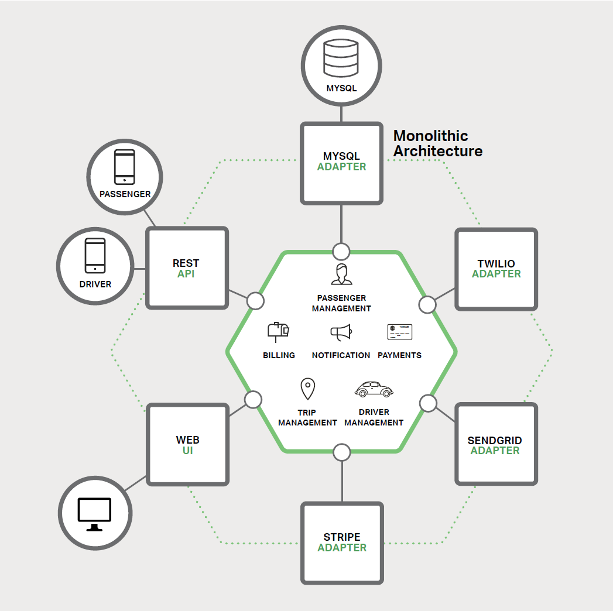
What is a Monolith?
Most applications built in the last 15 years
A large application core, composed of a single key technology
Typically surrounded by a layer of adapters that expose its functionality to the outside world and provide access to dependencies
Notes:
The above are some key characteristics of the monolith

Slide 6
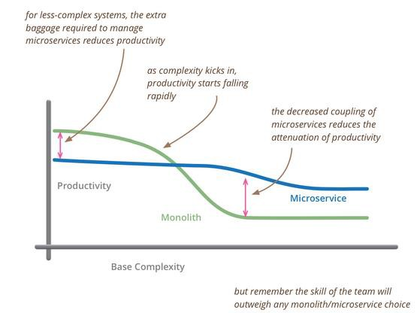
Shortcomings of the Monolith
Over time, application complexity grows, causing applications to grow stale and clunky.

Slide 7
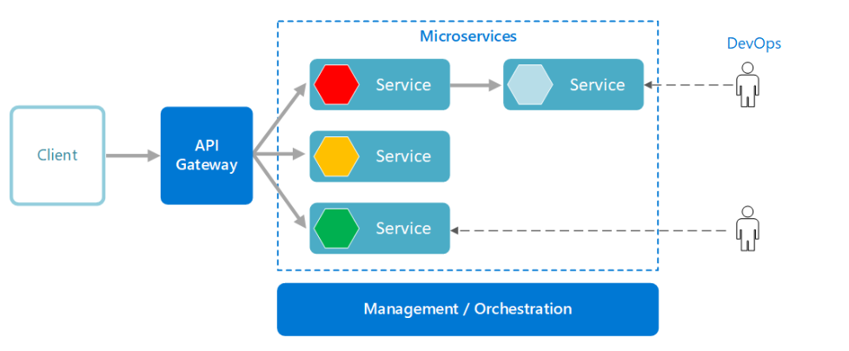
What are Microservices?
An approach to application development
Large application built around a collection of services
Distributed architecture
Notes:
At it’s core, the concept of the microservices architecture is an approach to application development, in which a large application is built as a collection of modular and cooperating services. However, in order to successfully achieve a robust microservices architecture, it is important for the underlying infrastructure to be correctly designed as well. In fact, due to the distributed nature of the microservices architecture, the line of what used to be separate as application details vs implementation details grows blurrier.
https://hackernoon.com/https-medium-com-spruha-pandya-of-microservices-containers-6f0ea25dac3
Containers simplify the continuous deployment of microservices

Slide 8
Microservices and Containers
Microservices
Containers
A large application core, composed of a single key technology
Typically surrounded by a layer of adapters that expose its functionality to the outside world and provide access to dependencies
Commonly deployed in containers
Provide fine-grained execution environment
Provide a high degree of isolation
Provide fast initialization and execution
Leverage orchestrators to manage microservice-based apps
Using container tools, help simplify complexities inherent in applications

Slide 9
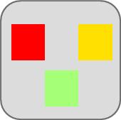

Traditional application approach
Microservices application approach
A traditional application has most functionality within a few componentized processes with layers and libraries.
Scales by cloning the app on multiple servers/VMs
App 1
A microservice application segregates functionality into separate smaller services.
Scales out by deploying each service independently with multiple instances across servers/VMs
App 1
App 2
Independent deployment and scale of microservices
Coarse-grained density of apps/services
Fine-grained density of services
Need to deploy and scale the full application
Notes:
Deployment models of monolithic vs microservices
Instantiate Services instead of spinning up new machines => faster
Better utilization of hardware
Optimize Cost
Lower time to market: more confident when it comes to upgrading a service
Services are independently:
- Implemented
- Deployed
- Scaled
- Versioned

Slide 10
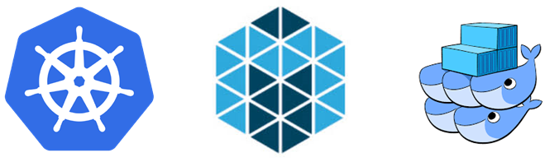
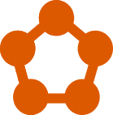
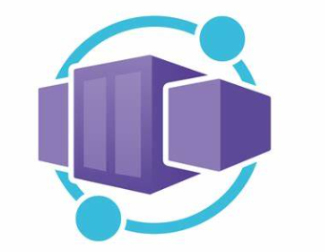
Why Container Orchestration?
Container orchestration is required to transition from deploying containers individually on a single host, to deploying complex multi-container apps on many machines. It requires a distributed platform, independent from infrastructure, that stays online through the entire lifetime of your application, surviving hardware failure and software updates.
Some of the main Container Orchestration Platforms:
Kubernetes
Mesos
Docker Swarm
Azure Service Fabric
Azure container Apps
Notes:
Kubernetes: Descended from a platform (Borg) that Google developed to manage its infrastructure, Kubernetes is well suited for very large cloud environments
Swarm: This is Docker’s home-grown orchestration platform. Docker claims it’s faster than the competition
Mesos: Hosted by Apache, Mesos is designed for general datacenter management, not just containers Mesosphere DC/OS commerical offering
Azure Service Fabric: A distributed systems platform that makes it easy to package, deploy, and manage scalable and reliable microservices and containers.

Slide 11
What is Container Orchestration?
Container orchestration is all about managing the lifecycles of containers, especially in large, dynamic environments. Container orchestration engines manage how multiple containers are created, upgraded, and made highly available.
The elements of orchestration
Scheduling
Affinity/anti-affinity
Health monitoring
Failover
Scaling
Networking
Service discovery
Coordinated app upgrades
Notes:
Container orchestration is all about managing the lifecycles of containers, especially in large, dynamic environments. Software teams use container orchestration to control and automate many tasks:
Provisioning and deployment of containers
Redundancy and availability of containers
Scaling up or removing containers to spread application load evenly across host infrastructure
Movement of containers from one host to another if there is a shortage of resources in a host, or if a host dies
Allocation of resources between containers
External exposure of services running in a container with the outside world
Load balancing of service discovery between containers
Health monitoring of containers and hosts
Configuration of an application in relation to the containers running it
Container orchestration automates the deployment, management, scaling, and networking of containers. Enterprises that need to deploy and manage hundreds or thousands of LinuxⓇ containers and hosts can benefit from container orchestration.
Container orchestration can be used in any environment where you use containers. It can help you to deploy the same application across different environments without needing to redesign it. And microservices in containers make it easier to orchestrate services, including storage, networking, and security.
Containers give your microservice-based apps an ideal application deployment unit and self-contained execution environment. They make it possible to run multiple parts of an app independently in microservices, on the same hardware, with much greater control over individual pieces and life cycles.
Managing the lifecycle of containers with orchestration also supports DevOps teams who integrate it into CI/CD workflows. Along with application programming interfaces (APIs) and DevOps teams, containerized microservices are the foundation for cloud-native applications
https://www.redhat.com/en/topics/containers/what-is-container-orchestration

Slide 12
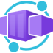
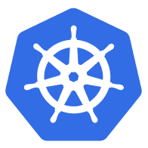



Azure Container Apps
Starting with Container Apps.
Serverless containers for microservices
Build modern apps on open source
Focus on apps, not infrastructure
Seamlessly port to Kubernetes
Kubernetes
KEDA
DAPR
Envoy
Notes:
We’re constantly seeing customers citing Kubernetes complexity as a blocker from adopting containers and microservices application patterns.
At Microsoft Ignite, we announced the public preview of Azure Container Apps.
Azure Container Apps is built on a foundation of powerful open-source technology to deliver the same microservices benefits as Kubernetes as a fully managed and serverless app hosting option. Behind the scenes, every container app runs on Azure Kubernetes Service, with Kubernetes Event Driven Autoscaling (KEDA), Distributed Application Runtime (Dapr), and Envoy deeply integrated in the hosting service. However, developers and operators are not exposed to this underlying Kubernetes infrastructure. The open-source centric approach enables a path for teams to build microservices without having to overcome the concept and operational overhead of working with Kubernetes directly and enables continued app portability by leveraging open standards and APIs

Slide 13

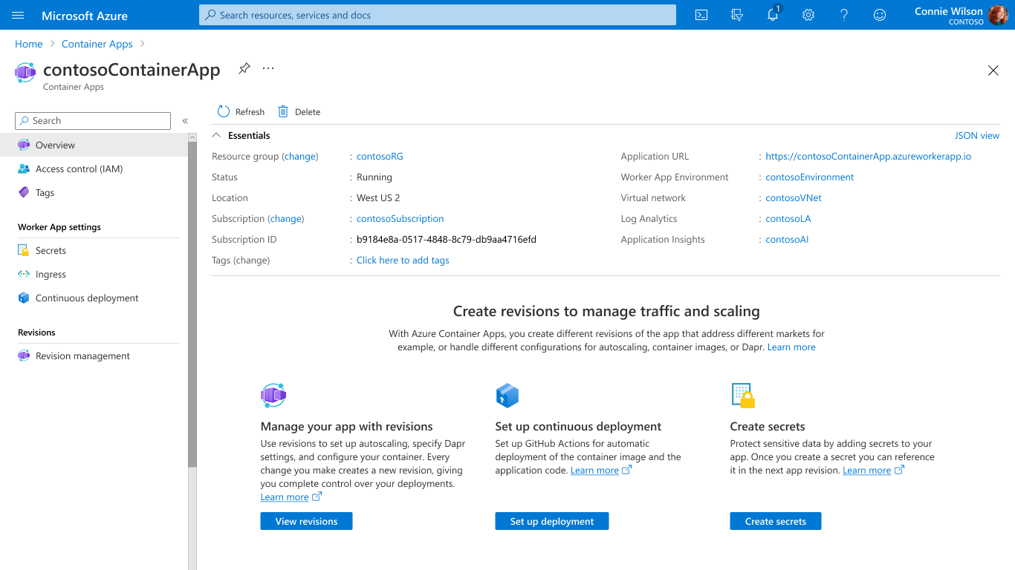
Scale with flexible serverless containers
Run containers, at scale
Accelerate developer productivity
Build modern apps on open-source
Run containers and scale in response to HTTP traffic or a growing list of KEDA-supported scale triggers including Azure Event Hub, Apache Kafka, RabbitMQ Queue, MongoDB, MySQL, and PostgreSQL
Get robust autoscaling capabilities without the overhead of managing complex infrastructure.
Scale to zero and pay for only what you use, by the second.
Notes:
Container Apps is the only serverless container solution offering a combination of robust built-in HTTP-based auto-scaling (including scale to zero), and event-driven auto-scale to run containers that may be processing messages from queues, streams, or databases.
You can run containers and scale in response to HTTP traffic or a growing list of KEDA-supported scale triggers including Azure Event Hub, Apache Kafka, RabbitMQ Queue, MongoDB, MySQL, and PostgreSQL. Scale to zero and pay for only what you use, by the second.

Slide 14
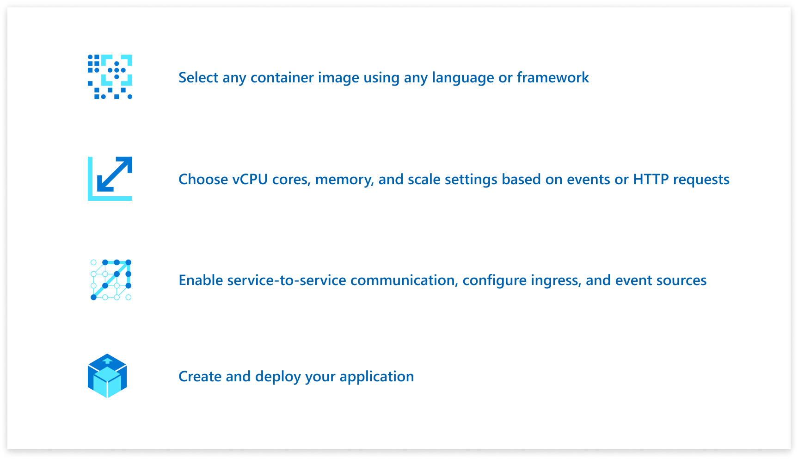
Accelerate developer productivity
Run containers, at scale
Accelerate developer productivity
Build modern apps on open-source
Build microservices, APIs, event processing workers, and background jobs using containers.
Write code in your favorite programming language and accelerate development with built-in Distributed Application Runtime (Dapr) integration to simplify common tasks like event processing, pub/sub, and service invocation.
Set up a code-to-cloud pipeline using GitHub Actions.
Notes:
Because you’re not burdened by managing a container orchestrator, this gives you more time to focus on building your applications. With Container Apps, you can build microservices, APIs, event processing workers, and background jobs using containers and any programming language or framework and easy code-to-cloud pipeline using GitHub Actions.
Through the built-in integration with Distributed Application Runtime (Dapr), you can simplify common tasks like event processing, pub/sub, service invocation, and more.

Slide 15
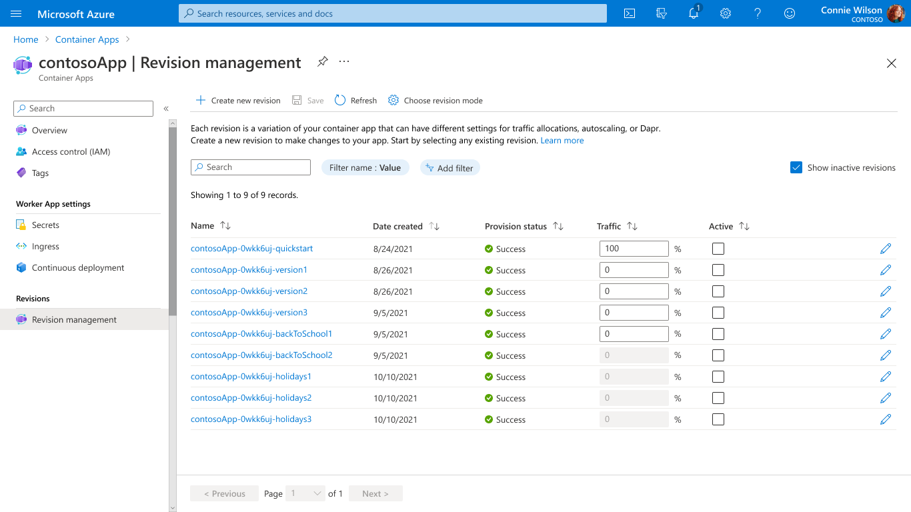
Build modern apps on open-source
Run containers, at scale
Accelerate developer productivity
Build modern apps on open-source
Create modern apps with open standards on a Kubernetes foundation and portability in mind.
Contribute directly to OSS projects to influence product capabilities.
Rely on streamlined application lifecycle tasks such as application upgrades and versioning, traffic shifting, service discovery, and monitoring.
Notes:
Container Apps is built on great open-source technology. It runs on top of Azure Kubernetes Service, KEDA, Dapr, and Envoy.
Perform modern application lifecycle tasks such as application upgrades, traffic shifting, and versioning with straightforward configurations. Rely on the built-in service discovery for microservice communication, fully managed HTTP and HTTP/2 ingress endpoints based on Envoy, and integrated load balancing, logging, and monitoring capabilities.

Slide 16
What can you build with Azure Container Apps?
Public API endpoints
Web
Apps
Event-driven processing
Background processing
Microservices
MICROSERVICE A
MICROSERVICE B
HTTP TRAFFIC
MICROSERVICE C
80%
20%
REVISION 1
REVISION 2
Microservices architecture with the option to integrate with Dapr
E.g., API app with HTTP requests split between two revisions of the app
E.g., Web app with custom domain, TLS certificates, and integrated authentication
E.g., Queue reader app that processes messages as they arrive in a queue
E.g., Continuously running background process transforms data in a database
AUTO-SCALE CRITERIA
Individual microservices can
scale independently using any KEDA scale triggers
Scaling is determined by the number of concurrent HTTP requests
Scaling is determined by the number of concurrent HTTP requests
Scaling is determined by the number of messages in the queue
Scaling is determined by the level of CPU or memory load
Notes:
You may be wondering what sort of applications can you build with Azure Container Apps?
Here are some common ones including:
Deploying API endpoints
Hosting background processing applications
Handling event-driven processing
Running microservices
With each of those applications, you can dynamically scale based on:
HTTP traffic
Event-driven processing
CPU or memory load
Any KEDA-supported scaler

Slide 17
Difference between ACA and other Azure Container Solutions
Notes:
Flexibility vs productivity

Slide 18
Azure Kubernetes Service and Azure Container Apps
Azure customers can easily deploy microservices using either Azure Kubernetes Service for flexible customized container solutions, or Azure Container Apps for productivity-optimized fully-managed serverless container solutions. Azure delivers app portability to support business growth powered by open-source in the Kubernetes ecosystem.
Cloud Native App Portability
Develop cloud native apps with open standards and APIs (e.g. Dapr) and port across Azure Container Apps and Azure Kubernetes Service.
Leverage Azure Container Apps guidance and tooling to port cloud native apps to Azure Kubernetes Service
Azure Container Apps is composed entirely of open source components available to build your own Azure Kubernetes Service solution.
Notes:
We’re constantly seeing customers citing Kubernetes complexity as a blocker from adopting containers and microservices application patterns.
At Microsoft Ignite, we announced the public preview of Azure Container Apps.
Azure Container Apps is built on a foundation of powerful open-source technology to deliver the same microservices benefits as Kubernetes as a fully managed and serverless app hosting option. Behind the scenes, every container app runs on Azure Kubernetes Service, with Kubernetes Event Driven Autoscaling (KEDA), Distributed Application Runtime (Dapr), and Envoy deeply integrated in the hosting service. However, developers and operators are not exposed to this underlying Kubernetes infrastructure. The open-source centric approach enables a path for teams to build microservices without having to overcome the concept and operational overhead of working with Kubernetes directly and enables continued app portability by leveraging open standards and APIs

Slide 19
How managed Kubernetes on Azure works
Automated upgrades, patches
High reliability, availability
Easy, secure cluster scaling
Self-healing
API server monitoring
At no charge
Azure managed control plane
App/ workload definition
Self-managed master node(s)
Kubernetes API endpoint
etcd Store
User
API server
Scheduler
Controller Manager
Cloud Controller
Schedule pods over private tunnel
Customer VMs
Docker
Docker
Docker
Docker
Docker
Pods
Pods
Pods
Pods
Pods

Slide 20
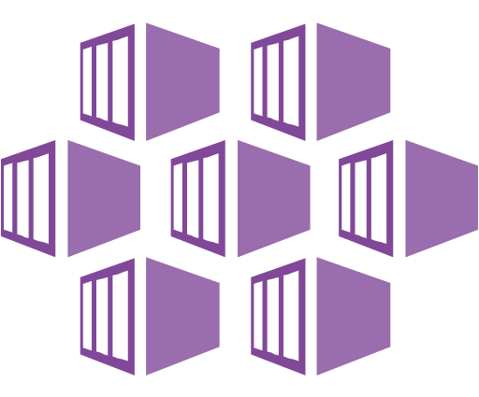
How does ACA compare to AKS?
Azure Kubernetes Service (AKS)
Azure Container Apps (ACA)
Infrastructure focus, higher flexibility
Application focus, infrastructure abstraction
Managed Kubernetes cluster in Azure with full access to the Kubernetes API server and high level of control over cluster configuration with a node-based pricing model
Fully-managed serverless abstraction on top of Kubernetes infrastructure, purpose built for managing and scaling event-driven microservices with a consumption-based pricing model
Core value proposition
UpstreaOperations flexibility with advanced customization
m feature parity with a managed control plane
Experienced Kubernetes operators
Platform-as-a-Service experience with serverless scale
Developer productivity with low operations overhead
Linux-based, general-purpose stateless containers
Optimized for
Operators deploy node-based AKS clusters using Azure Portal, CLI or Infrastructure-as-Code templates (IaC)
Developers deploy containers via Kubernetes deployment manifests or HELM charts to logically-isolated namespaces within the cluster
Developers deploy containers as individual Container Apps using Azure Portal, CLI or IaC templates without any Kubernetes manifests required
Related container apps are deployed to a shared Container Apps environment comparable to a Kubernetes namespace
Interaction model
Provides a set of cluster extensions and add-ons for operators to enable OSS components in-cluster including Dapr, KEDA, Open Service Mesh, GitOps (Flux), Pod Identity, etc.
Supports manual installation via Kubernetes manifests
Includes opinionated platform capabilities powered by CNCF projects including Dapr, KEDA and Envoy which are fully platform-managed and supported
Envoy: managed ingress and traffic splitting
KEDA: managed, event-driven autoscale
Dapr: codified best practices for microservices
OSS Integration
Notes:
Flexibility vs productivity

Slide 21
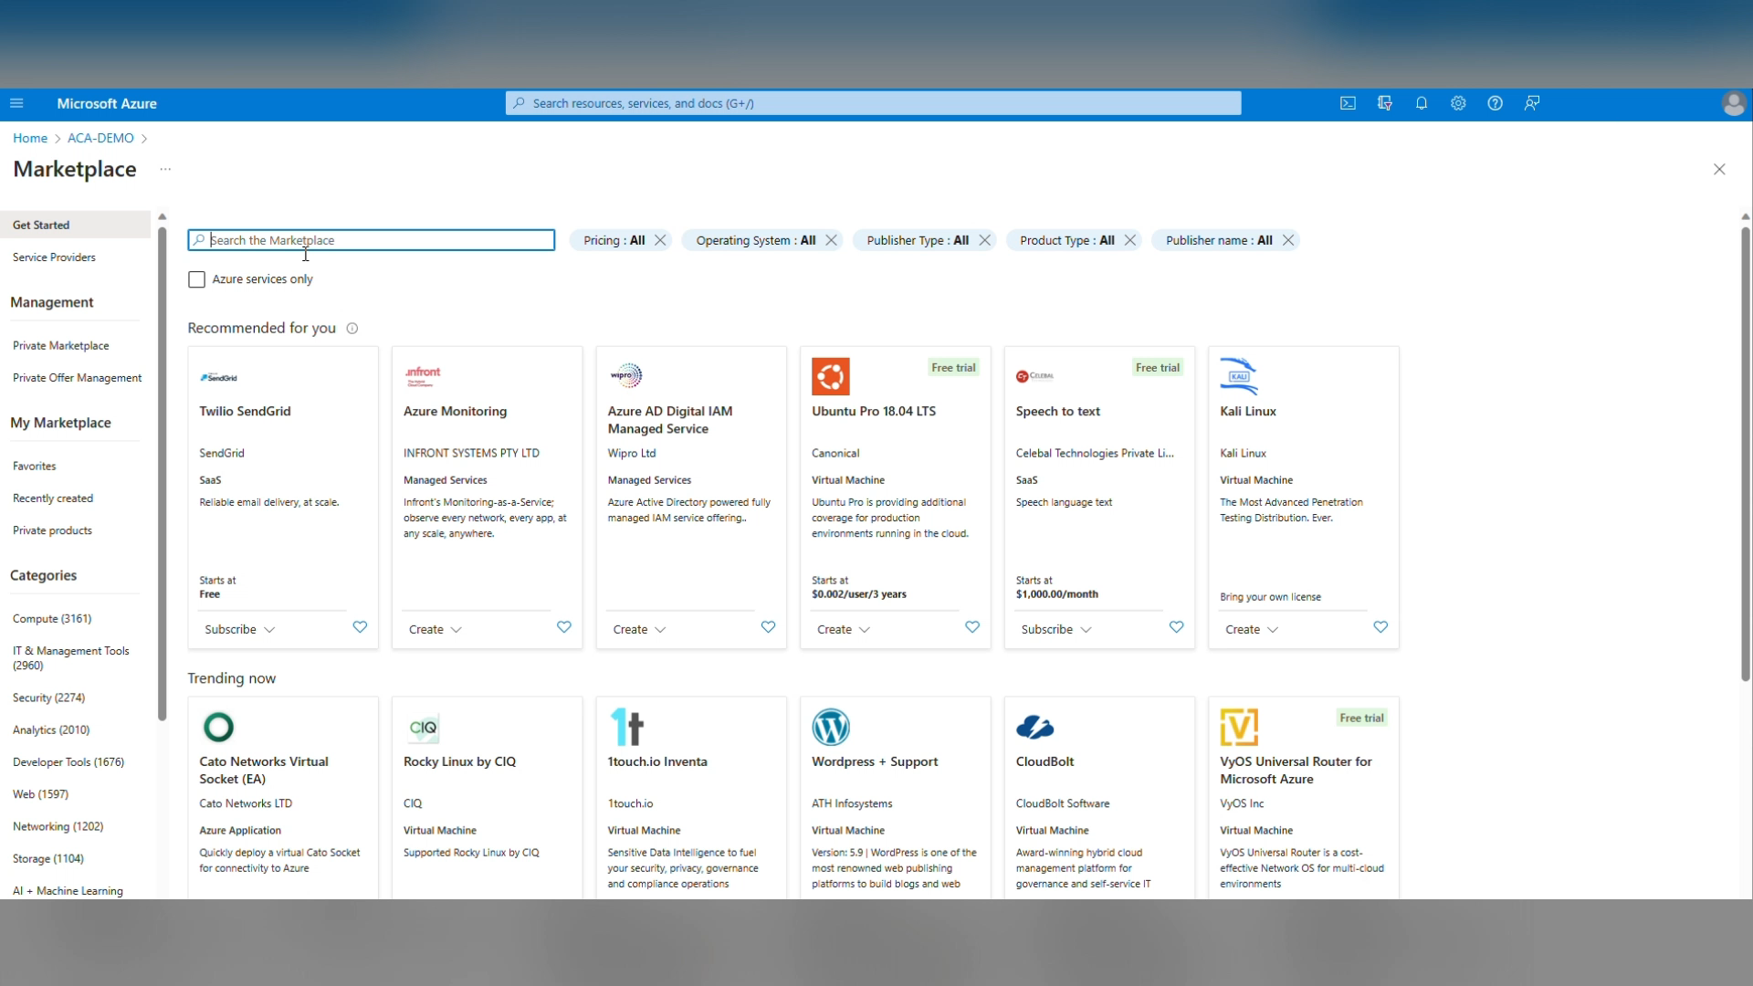
ACA Portal deployment -demo

Slide 22
Azure Container Apps Demo
Notes:
Flexibility vs productivity

Slide 23
Module: 2
Building Azure Container apps Environment
Multiple Containers
​
Container Registries
Understanding Revisions in ACA

Slide 24
Azure container apps deployment options
Azure Portal Deployment
Azure cli deployment
ARM template deployment
Bicep template deployment
Terraform template deployment
az containerapp | Microsoft Learn
Quickstart - create a container instance - Bicep - Azure Container Instances | Microsoft Learn
Microsoft.App/containerApps - Bicep, ARM template & Terraform AzAPI reference | Microsoft Learn

Slide 25
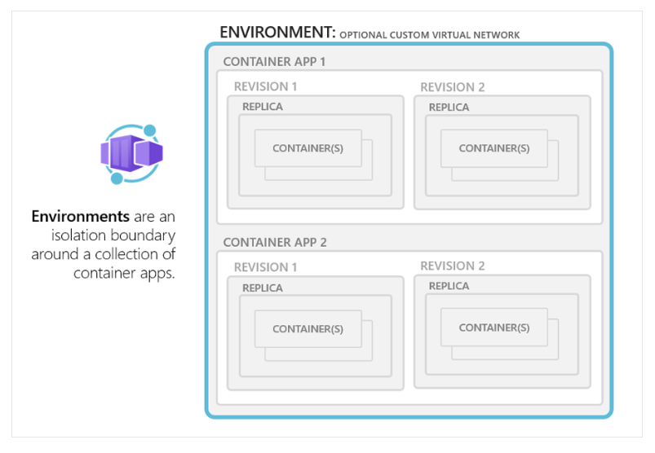
Building Azure container apps environment.
A Container Apps environment is a secure boundary around groups of container apps that share the same virtual network and write logs to the same logging destination.
Container Apps environments are fully managed where Azure handles OS upgrades, scale operations, failover procedures, and resource balancing.

Slide 26
Container app environment
Reasons to deploy container apps to the same environment :
Manage related services
Deploy different applications to the same virtual network
Instrument Dapr applications that communicate via the Dapr service invocation API
Have applications to share the same Dapr configuration
Have applications share the same log analytics workspace
Also, you may provide an existing virtual network when you create an environment.
Reasons to deploy container apps to different environments :
Two applications never share the same compute resources
Two Dapr applications can't communicate via the Dapr service invocation API

Slide 27
Billing for ACA
Consumption only
Dedicated plan
If you're using the Consumption only plan, or only the Consumption workload profile in the Consumption + Dedicated plan structure then billing is relevant only to individual container apps and their resource usage. There's no cost associated with the Container Apps environment.
If you're using any Dedicated workload profiles in the Consumption + Dedicated plan structure, there's a fixed cost for the Dedicated plan management. This cost is for the entire environment regardless of how many Dedicated workload profiles you're using.
Notes:
Azure Container Apps environments | Microsoft Learn

Slide 28
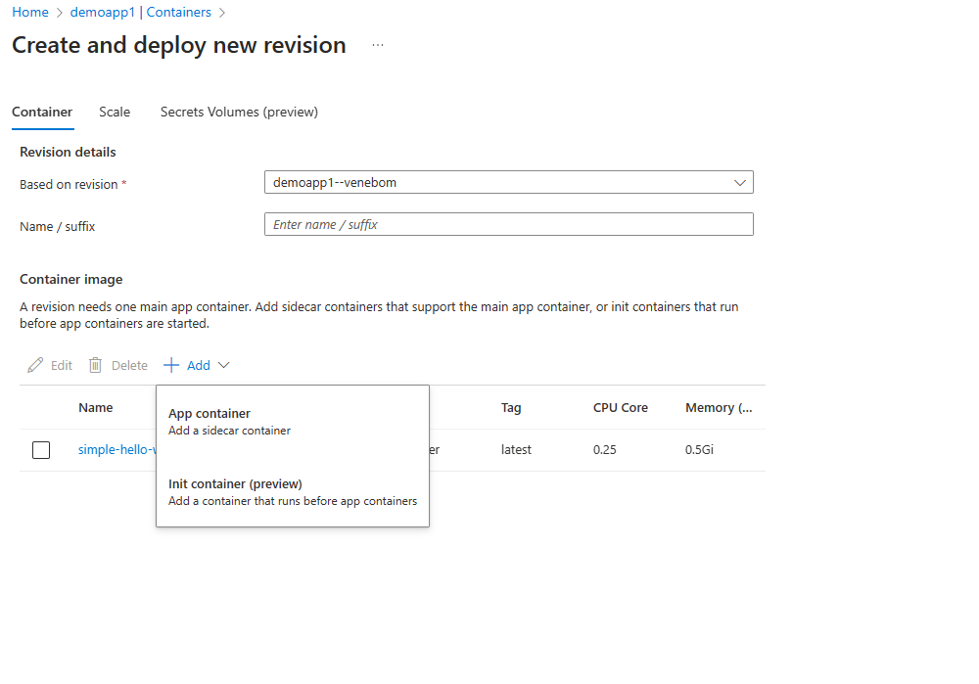
Multiple containers
App container
Init Container

Slide 29
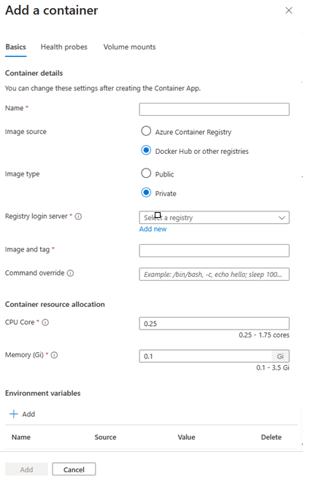
Container registries
Azure container registry
Docker Hub and other registries.
Public and Private

Slide 30
Walk through Azure container registry in Portal - Demo
https://portal.azure.com/
Notes:
ACA vs AKS: Azure Services for Containerized Apps (microsoft.com)

Slide 31
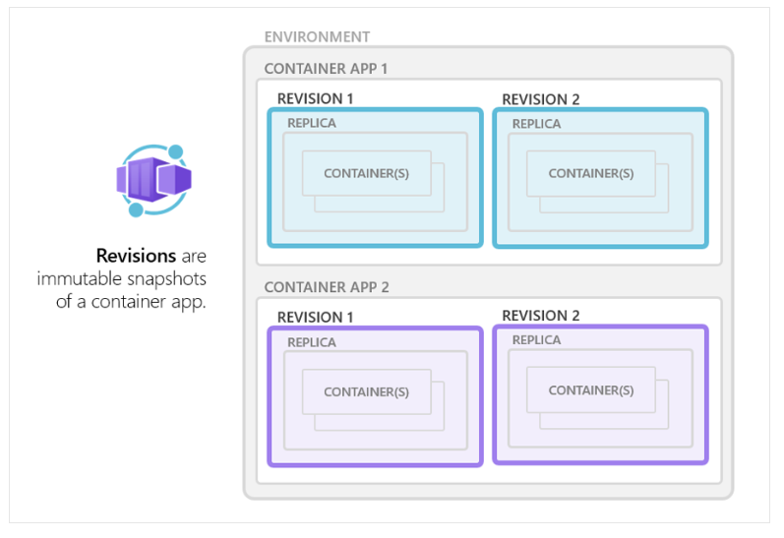
Understanding revisions in ACA
Azure Container Apps implements container app versioning by creating revisions. A revision is an immutable snapshot of a container app version.
The first revision is automatically provisioned when you deploy your container app.
New revisions are automatically provisioned when you make a revision-scope change to your container app.
While revisions are immutable, they're affected by application-scope changes, which apply to all revisions.
You can create new revisions by updating a previous revision.
You can retain up to 100 revisions, giving you a historical record of your container app updates.
You can run multiple revisions concurrently.
You can split external HTTP traffic between active revisions.

Slide 32
Revisions
Environment (virtual network boundary)
Container app 1
Revision 1
Revision 2
Pod
Pod
Pod
Pod
Revisions are immutable version snapshots of a container app
Container(s)
Container(s)
Container(s)
Container(s)
Container app 2
Revision 1
Revision 2
Pod
Pod
Container(s)
Container(s)
Notes:
A revision is an immutable snapshot of a container app.
The first revision is automatically created when you deploy your container app.
New revisions are automatically created when a container app's template configuration changes.
While revisions are immutable, they're affected by changes to global configuration values, which apply to all revisions.
Revisions are most useful when you enable ingress to make your container app accessible via HTTP. Revisions are often used when you want to direct traffic from one snapshot of your container app to the next. Typical traffic direction strategies include A/B testing and BlueGreen deployment.

Slide 33
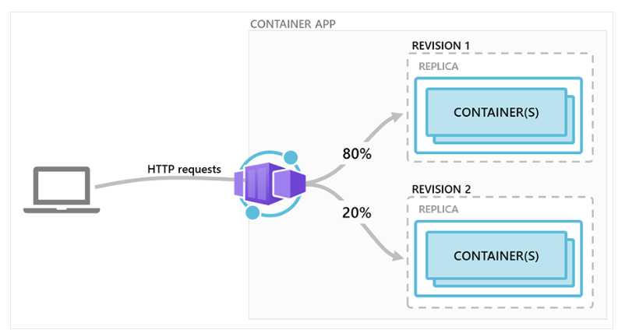
Multiple revisions
This scenario presumes the container app is in the following state:
Ingress is enabled, making the container app available via HTTP or TCP.
The first revision was deployed as Revision 1.
After the container was updated, a new revision was activated as Revision 2.
Traffic splitting rules are configured so that Revision 1 receives 80% of the requests, and Revision 2 receives the remaining 20%.

Slide 34
Containers
Environment (virtual network boundary)
Container app 1
Revision 1
Revision 2
Pod
Pod
Pod
Pod
Containers in Azure Container Apps can use any and development stack of your choice
Container(s)
Container(s)
Container(s)
Container(s)
Container app 2
Revision 1
Revision 2
Pod
Pod
Container(s)
Container(s)
Notes:
Azure Container Apps manages the details of Kubernetes and container orchestrations for you. Containers in Azure Container Apps can use any runtime, programming language, or development stack of your choice.
Azure Container Apps supports:
Any Linux-based container image
Containers from any public or private container registry
However, Azure Container Apps can't run privileged containers or processes that requires root access.
Additional features include:
There is no required base container image.
Changes to the template ARM configuration section triggers a new container app revision.
If a container crashes, it automatically restarts.
You can define multiple containers in a single container app. Groups of containers are known as pods. The containers in a pod share hard disk and network resources and experience the same application lifecycle.
Reasons to run containers together in a pod include:
Use a container as a sidecar to your primary app.
Use of a shared disk space and virtual network.
Share scale rules among containers.
Group together multiple containers that need to always run together.
Enable direct communication among containers on the same host.

Slide 35
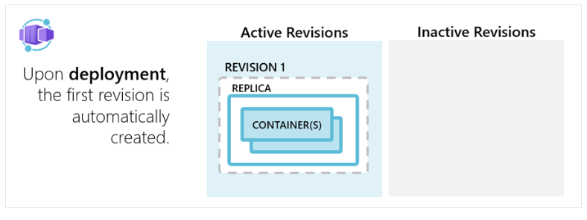
Application lifecycle management with ACA

Slide 36
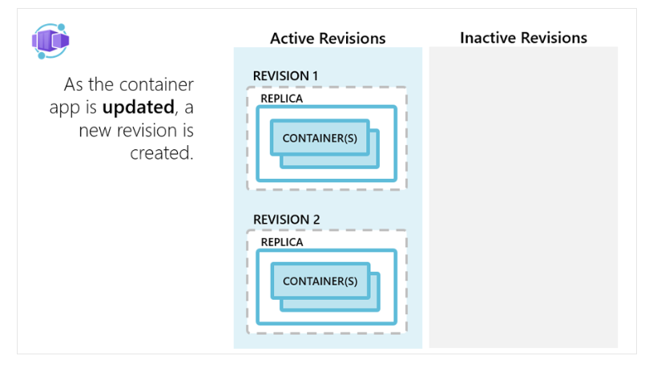
Application lifecycle management with ACA

Slide 37
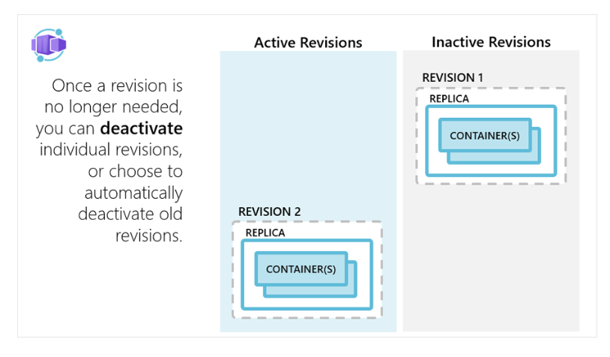
Application lifecycle management with ACA

Slide 38
Secrets management
"template": {
"containers": [
{
"image": "myregistry/myQueueApp:v1",
"name": "myQueueApp",
"env": [
{
"name": "QueueName",
"value": "myqueue"
},
{
"name": "ConnectionString",
"secretref": "queue-connection-string"
}
]
}
],
}
Securely store sensitive configuration elements that are then available to containers through environment variables, scale rules, and Dapr
Notes:
Azure Container Apps allows your application to securely store sensitive configuration values. Once defined at the application level, secured values are available to containers, inside scale rules, and via Dapr.
Secrets are scoped to an application, outside of any specific revision of an application.
Adding, removing, or changing secrets does not generate new revisions.
Each application revision can reference one or more secrets.
Multiple revisions can reference the same secret(s).
When a secret is updated or deleted, you can respond to changes in one of two ways:
Deploy a new revision.
Restart an existing revision.

Slide 39
Shutdown
The containers are shut down in the following situations:
As a container app scales in
As a container app is being deleted
As a revision is being deactivated
When a shutdown is initiated, the container host sends a SIGTERM message to your container. The code implemented in the container can respond to this operating system-level message to handle termination.
If your application doesn't respond within 30 seconds to the SIGTERM message, then SIGKILL terminates your container.
Additionally, make sure your application can gracefully handle shutdowns. Containers restart regularly, so don't expect state to persist inside a container. Instead, use external caches for expensive in-memory cache requirements.

Slide 40
Lab: 1
Exercise 1 - Deploy Backend API to ACA
Exercise 2 - Communication Between Microservices in ACA
Notes:
Refer to the following two modules in the lab - Azure Container Apps - Workshop
Module 1 - Deploy Backend API to ACA
Module 2 - Communication Between Microservices in ACA

Slide 41
Module: 3
Understanding Dapr integration​

Slide 42
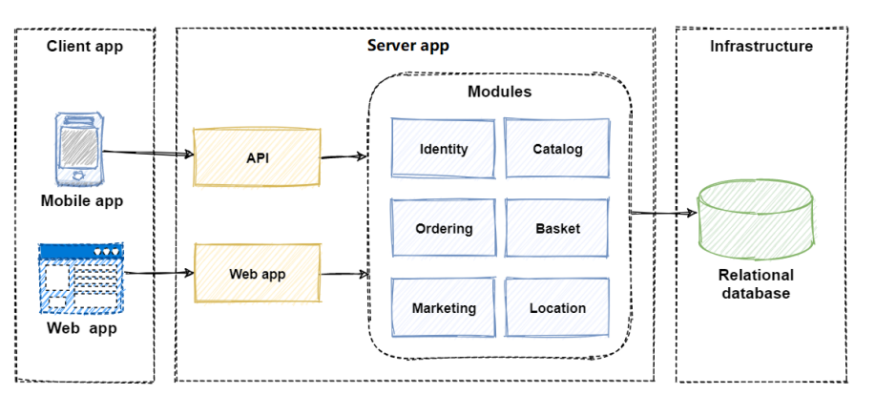
Dapr (distributed application runtime)
What is Distributed application ?
Why distributed application runtime is required ?
Monolithic application architecture

Slide 43
Monolithic application management overhead
The monolith has become so overwhelmingly complicated that no single person understands it.
You fear making changes as each brings unintended and costly side effects.
New features/fixes become time-consuming and expensive to implement.
Even the smallest change requires full deployment of the entire application - expensive and risky.
One unstable component can crash the entire system.
Adding new technologies and frameworks aren’t an option.
Implementing agile delivery methodologies are difficult.
Architectural erosion sets in as the code base deteriorates with never-ending “special cases.”
Eventually the consultants come in and tell you to rewrite it

Slide 44

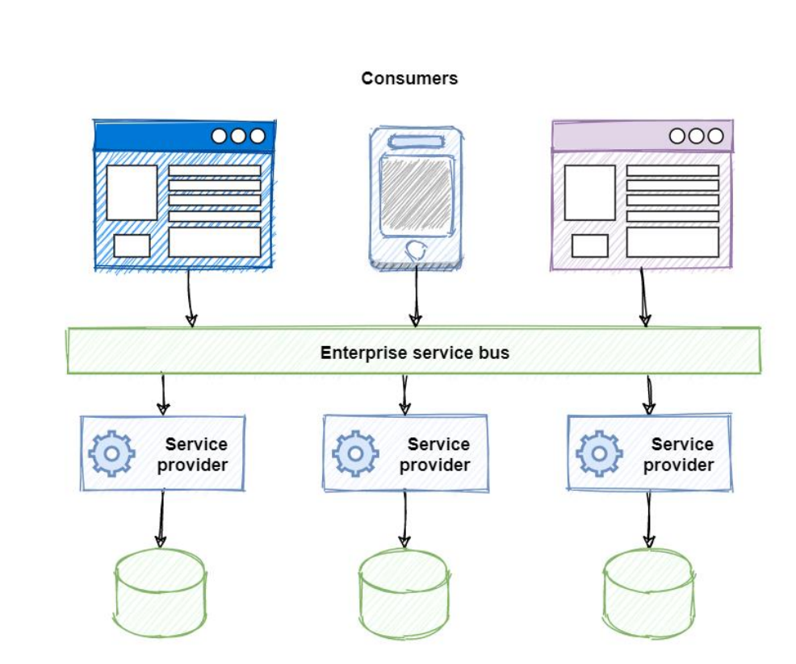
Dapr – continued..

Slide 45
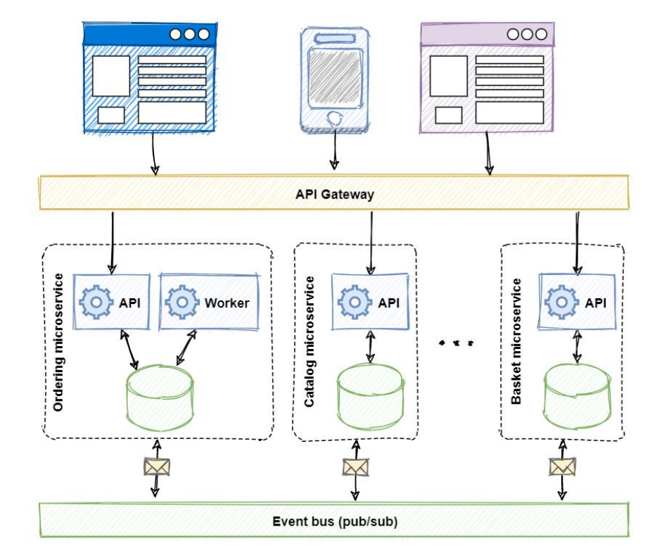
Dapr
Distributed architecture.

Slide 46
Distributed architecture. How ??
How can distributed services discover each other and communicate synchronously?
How can they implement asynchronous messaging?
How can they maintain contextual information across a transaction?
How can they become resilient to failure?
How can they scale to meet fluctuating demand?
How are they monitored and observed

Slide 47
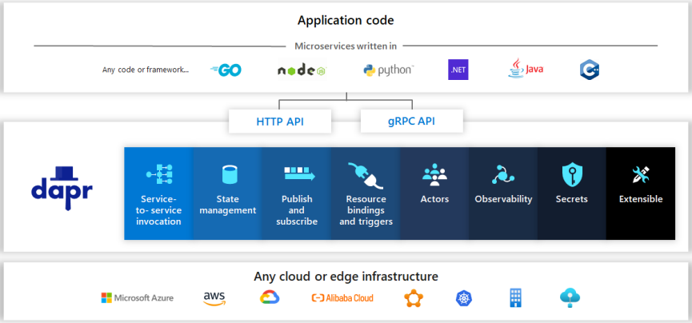
Dapr overview 20,000 feet.
Dapr, or Distributed Application Runtime, is a new way to build modern distributed applications

Slide 48
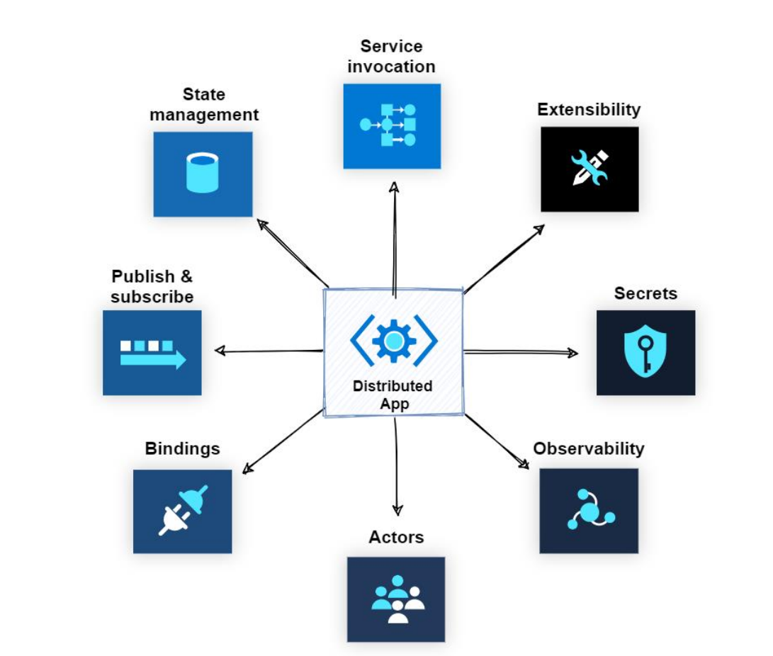
Dapr Building blocks

Slide 49
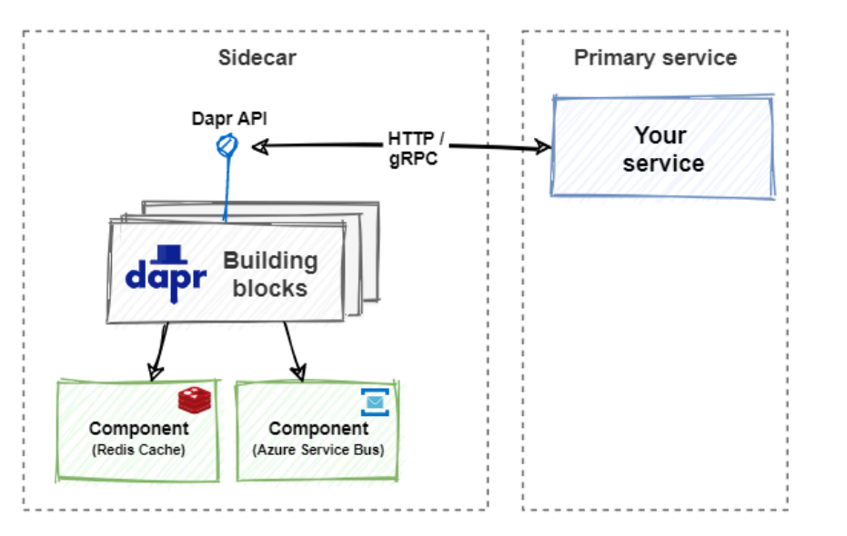
Sidecar architecture

Slide 50
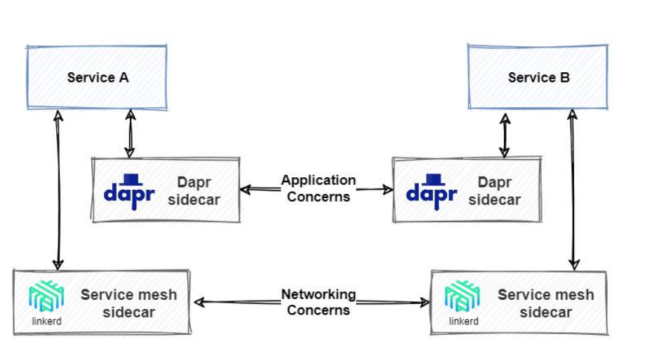
Dapr and Service mesh together

Slide 51
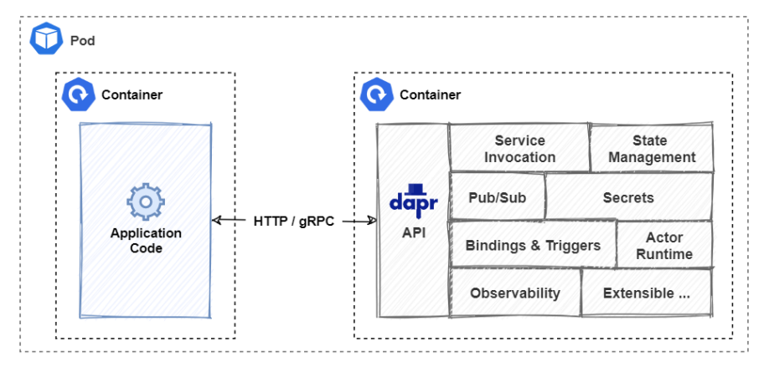
Dapr with Kubernetes
Kubernetes-hosted Dapr sidecar.

Slide 52
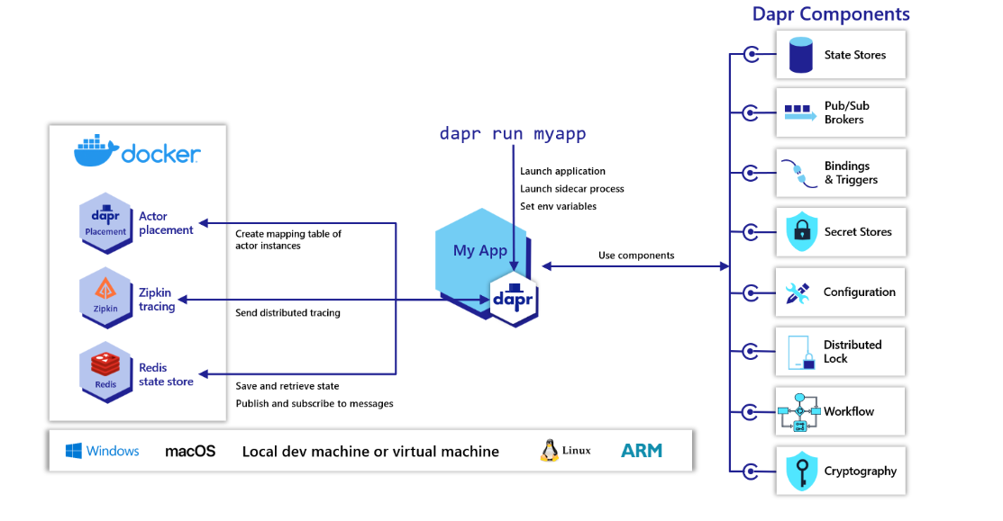
Overview of Dapr in self-hosted mode
Dapr can be configured to run in self-hosted mode on your local developer machine or on production VMs. Each running service has a Dapr runtime process (or sidecar) which is configured to use state stores, pub/sub, binding components and the other building blocks. Overview of Dapr in self-hosted mode | Dapr Docs
How-To: Invoke services using HTTP | Dapr Docs

Slide 53
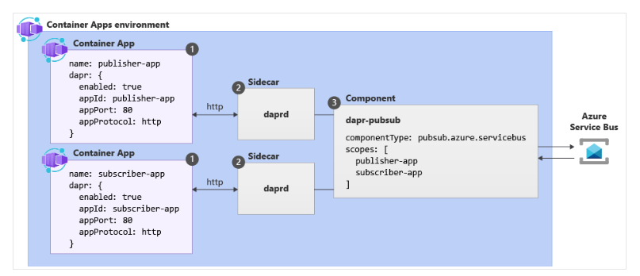
How Dapr works with Azure container Apps
Notes:
Dapr integration with Azure Container Apps | Microsoft Learn

Slide 54
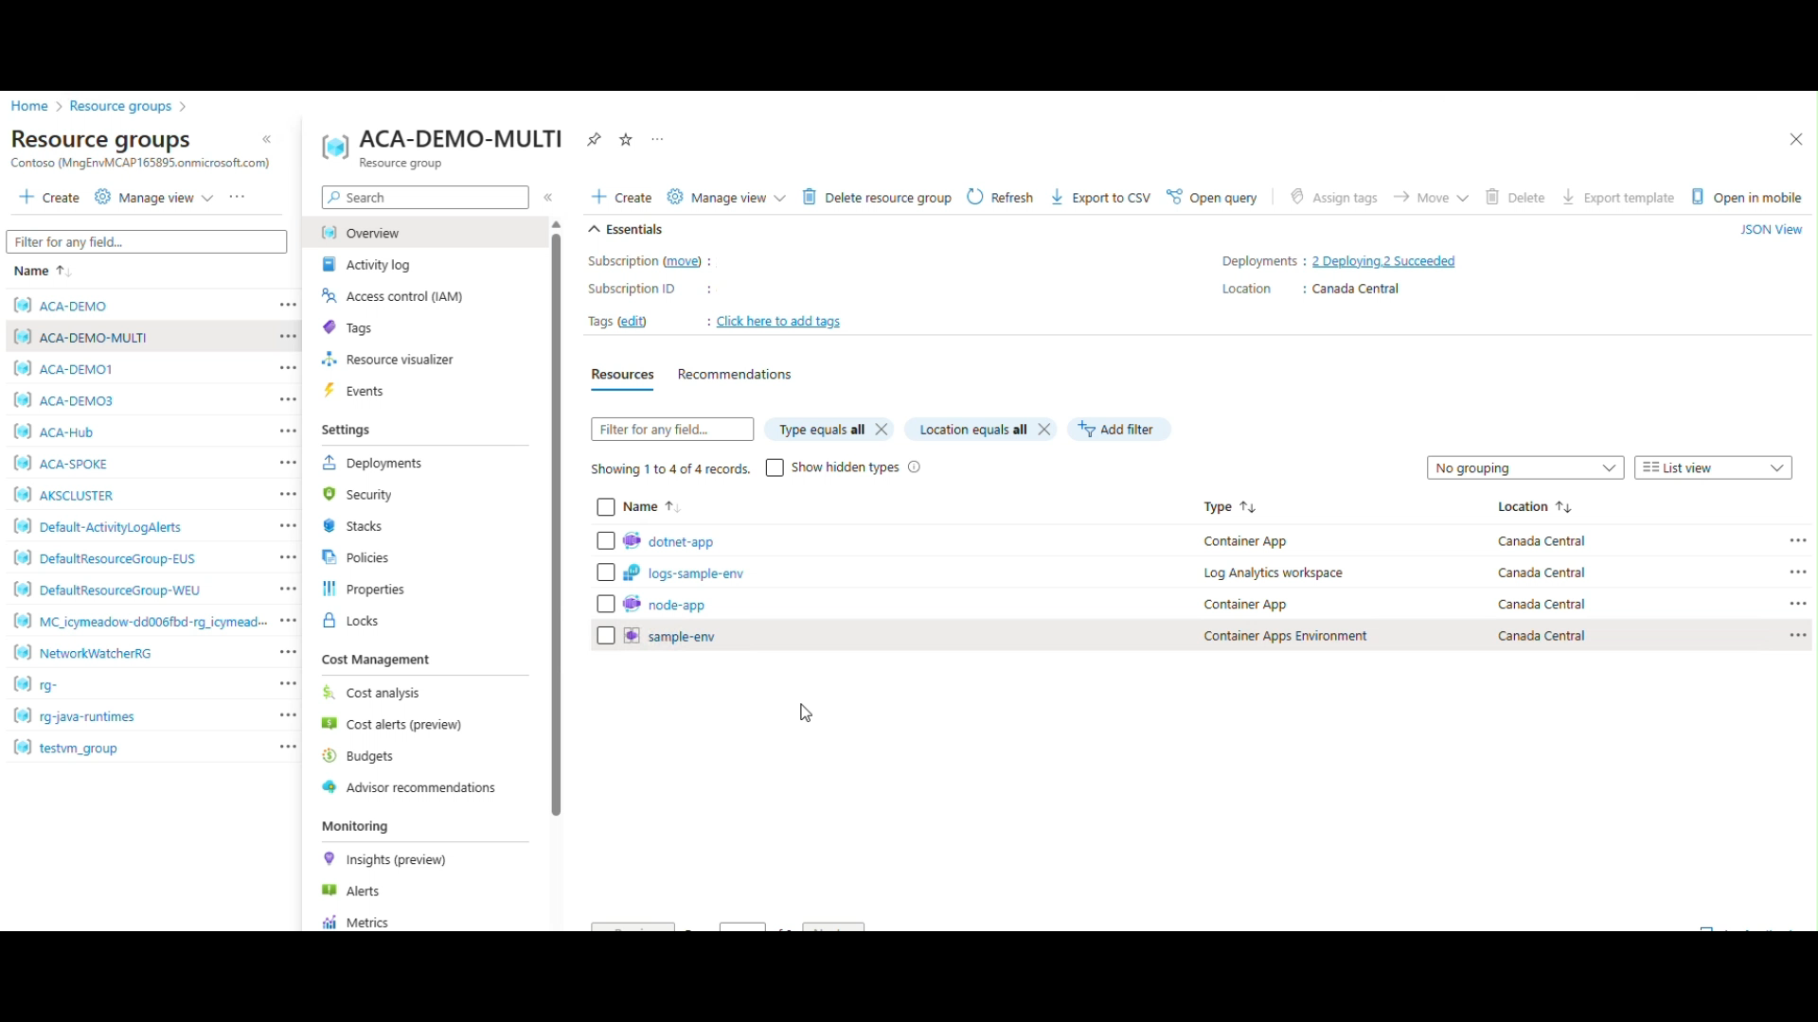
ACA Multi container app communication
Notes:
Azure-Samples/container-apps-connect-multiple-apps: Azure Sample showing how to connect and call multiple container apps within the same environment. Shows the approach to use both with and without Dapr. (github.com)

Slide 55
Dapr Component example
az containerapp env dapr-component set --name ENVIRONMENT_NAME --resource-group RESOURCE_GROUP_NAME --dapr-component-name pubsub --yaml "./pubsub.yaml"
# pubsub.yaml for Azure Service Bus component
componentType: pubsub.azure.servicebus.queue
version: v1
secretStoreComponent: "my-secret-store"
metadata:
- name: connectionString
secretRef: sb-root-connectionstring
scopes:
- publisher-app
- subscriber-app

Slide 56
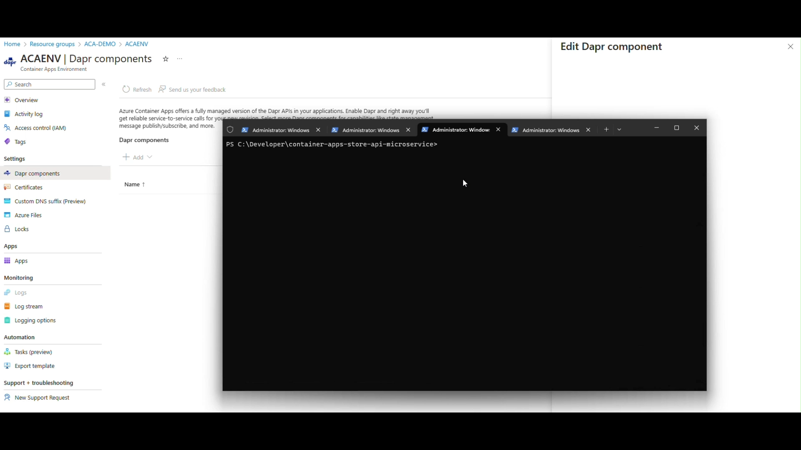
Dapr Component example -Demo

Slide 57
Lab: 2
Exercise 3 - Dapr Integration with ACA
Exercise 4 - ACA State Store With Dapr State Management API
Notes:
Refer to the following two modules in the lab - Azure Container Apps - Workshop
Module 3 - Dapr Integration with ACA
Module 4 - ACA State Store With Dapr State Management API

Slide 58
Module:4
Azure container apps Networking Architecture
Storage configuration with Azure container apps

Slide 59
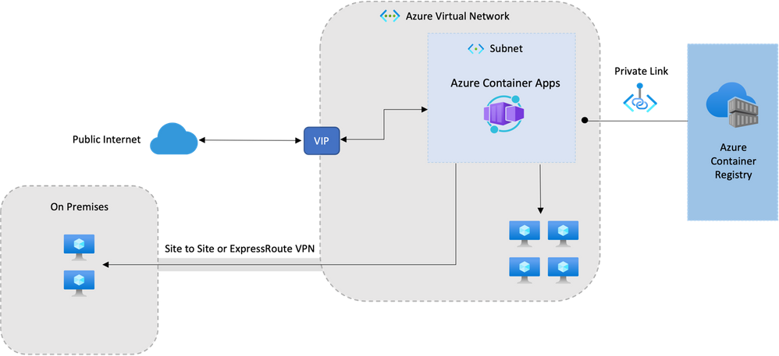
ACA Network architecture

Slide 60
Networking architecture in Azure Container Apps
Azure Container Apps run in the context of an environment, which is supported by a virtual network (VNET).
When you create an environment, you can provide a custom VNET, otherwise a VNET is automatically generated for you.
Generated VNETs are inaccessible to you as they're created in Microsoft's tenant.
To take full control over your VNET, provide an existing VNET to Container Apps as you create your environment.

Slide 61
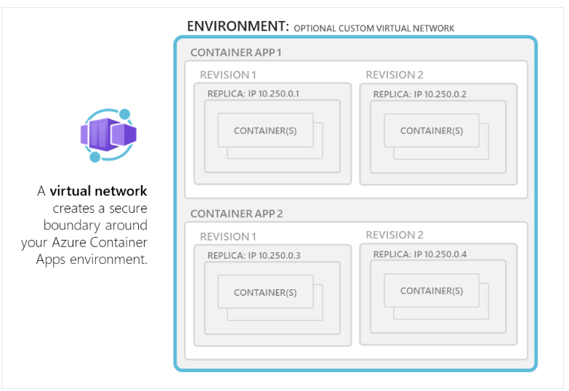
ACA Network architecture
Environment Selection
Consumption only environment
Workload profiles environment (preview)

Slide 62
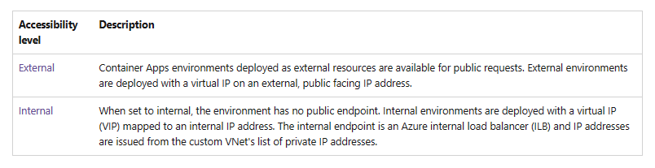
ACA Network architecture
Accessibility Levels
In Container Apps, you can configure whether your container app allows public ingress or only ingress from within your VNet at the environment level.

Slide 63
ACA Network architecture continued
Custom Vnet configuration
if you want your container app to restrict all outside access, create an internal Container Apps environment.
When you provide your own VNet, you need to provide a subnet that is dedicated to the Container App environment you deploy. This subnet isn't available to other services.
Network addresses are assigned from a subnet range you define as the environment is created.
You can define the subnet range used by the Container Apps environment.
You can restrict inbound requests to the environment exclusively to the VNet by deploying the environment as internal.

Slide 64
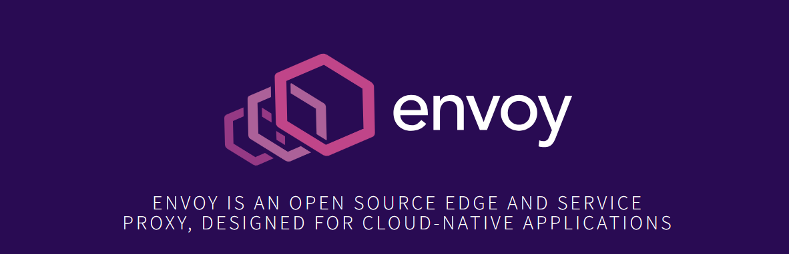
ACA Network architecture
HTTP edge proxy behavior
Envoy Proxy - Home
Azure Container Apps uses Envoy proxy as an edge HTTP proxy. TLS is terminated on the edge and requests are routed based on their traffic splitting rules and routes traffic to the correct application.

Slide 65
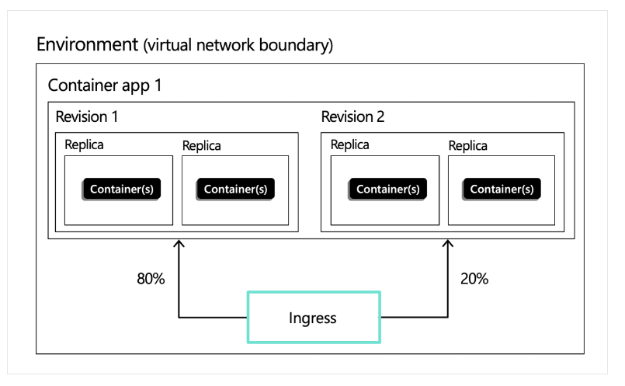
Ingress in Azure Container Apps
External and internal ingress
External: Accepts traffic from both the public internet and your container app's internal environment.
Internal: Allows only internal access from within your container app's environment.

Slide 66
Ingress in Azure Container Apps
Protocol types
Container Apps supports two protocols for ingress: HTTP and TCP.
HTTP
With HTTP ingress enabled, container app has:
Support for TLS termination
Support for HTTP/1.1 and HTTP/2
Support for WebSocket and gRPC
HTTPS endpoints that always use TLS 1.2, terminated at the ingress point
Endpoints that expose ports 80 (for HTTP) and 443 (for HTTPS)
By default, HTTP requests to port 80 are automatically redirected to HTTPS on 443
A fully qualified domain name (FQDN)
Request timeout is 240 seconds

Slide 67
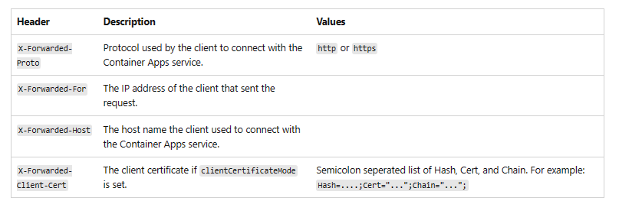
Ingress in Azure Container Apps
HTTP headers
HTTP ingress adds headers to pass metadata about the client request to your container app

Slide 68
Ingress in Azure Container Apps
TCP
Container Apps supports TCP-based protocols other than HTTP or HTTPS. For example, you can use TCP ingress to expose a container app that uses the Redis protocol

Slide 69
Ingress in Azure Container Apps
Accessibility level:
You can set your container app as externally or internally accessible in the environment. An environment variable CONTAINER_APP_ENV_DNS_SUFFIX is used to automatically resolve the FQDN suffix for your environment. When communicating between Container Apps within the same environment, you may also use the app name.
Traffic split rules:
You can define traffic splitting rules between different revisions of your application.

Slide 70
Scenarios
Rapid iteration
In situations where you're frequently iterating development of your container app, you can set traffic rules to always shift all traffic to the latest deployed revision.
The following example routes all traffic to the latest deployed revision:
"ingress": {
"traffic": [
{
"latestRevision": true,
"weight": 100
}
]
}

Slide 71
Scenarios
Once you're satisfied with the latest revision, you can lock traffic to that revision by updating the ingress settings to:
"ingress": {
"traffic": [
{
"latestRevision": false, // optional
"revisionName": "myapp--knowngoodrevision",
"weight": 100
}
]
}

Slide 72
Update existing revision
Consider a situation where you have a known good revision that's serving 100% of your traffic, but you want to issue an update to your app. You can deploy and test new revisions using their direct endpoints without affecting the main revision serving the app.
Once you're satisfied with the updated revision, you can shift a portion of traffic to the new revision for testing and verification.
The following configuration demonstrates how to move 20% of traffic over to the updated revision:
"ingress": {
"traffic": [
{
"revisionName": "myapp--knowngoodrevision",
"weight": 80
},
{
"revisionName": "myapp--newerrevision",
"weight": 20
}
]
}

Slide 73
Staging microservices
When building microservices, you may want to maintain production and staging endpoints for the same app. Use labels to ensure that traffic doesn't switch between different revisions.
The following example demonstrates how to apply labels to different revisions.
"ingress": {
"traffic": [
{
"revisionName": "myapp--knowngoodrevision",
"weight": 100
},
{
"revisionName": "myapp--98fdgt",
"weight": 0,
"label": "staging"
}
]
}

Slide 74
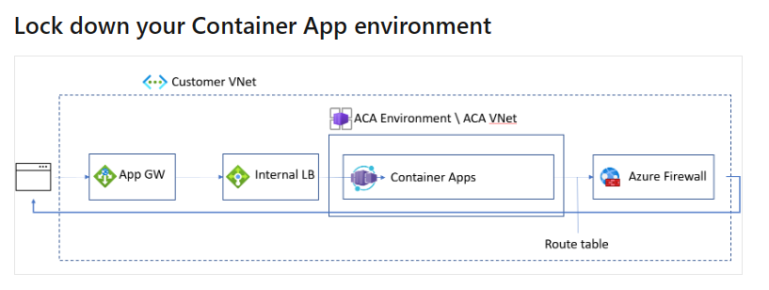
Locking down Container app environment
Create your internal container app environment on the workload profiles environment.
Integrate your Container Apps with an Application Gateway.
Configure UDR to route all traffic through Azure Firewall.

Slide 75
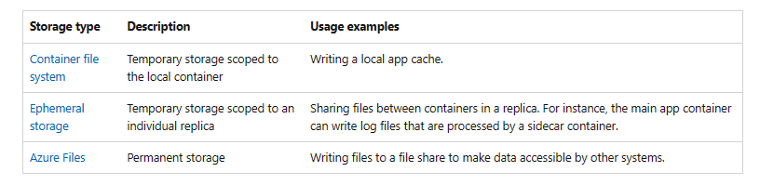
Storage configuration for ACA
A container app has access to different types of storage. A single app can take advantage of more than one type of storage if necessary.

Slide 76
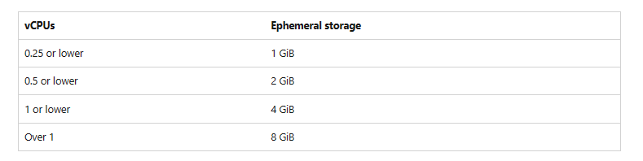
Storage for ACA
Ephemeral volume
Ephemeral storage is scoped to a single replica.
Files are persisted for the lifetime of the replica.
If a container in a replica restarts, the files in the volume remain.
Any containers in the replica can mount the same volume.
A container can mount multiple ephemeral volumes.
The available storage depends on the total amount of vCPUs allocated to the replica.
To configure ephemeral storage, first define an EmptyDir volume in the revision. Then define a volume mount in one or more containers in the revision.

Slide 77
Lab: 3
Exercise 5 - ACA Async Communication with Dapr Pub/Sub API
Exercise 6 - ACA with Dapr Bindings Building Block
Exercise 7 - ACA Scheduled Jobs with Dapr Cron Binding
Notes:
Refer to the following two modules in the lab - Azure Container Apps - Workshop
Module 5 - ACA Async Communication with Dapr Pub/Sub API
Module 6 - ACA with Dapr Bindings Building Block
Module 7 - ACA Scheduled Jobs with Dapr Cron Binding

Slide 78
Module: 5
Observability in Azure Container Apps

Slide 79
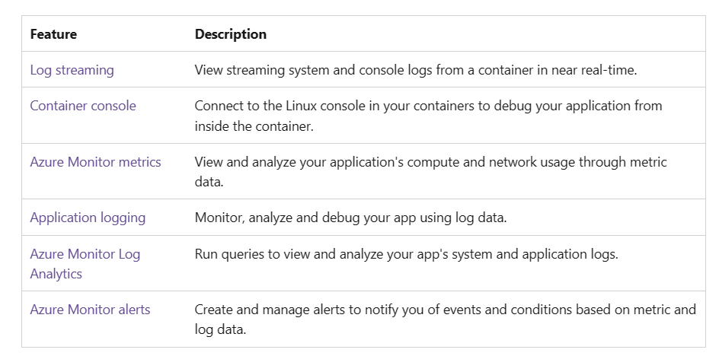
Observability in Azure Container Apps
Azure Container Apps provides several built-in observability features that together give you a holistic view of your container app’s health throughout its application lifecycle
These features help in monitoring and diagnosing the state of application to improve performance and respond to trends and critical problems.

Slide 80
Application lifecycle observability
Development and test
During the development and test phase, real-time access to containers' application logs and console is critical for debugging issues. Container Apps provides:
Log streaming: View real-time log streams from your containers.
Container console: Access the container console to debug your application.
Deployment
After deploying the container app, continuous monitoring helps in quickly identifying the problems that may occur around error rates, performance, and resource consumption.
Azure Monitor metrics: Monitor and analyze key metrics.
Azure Monitor alerts: Receive alerts for critical conditions.
Azure Monitor Log Analytics: View and analyze application logs.
Maintenance
Container Apps manages updates to your container app by creating revisions. You can run multiple revisions concurrently in blue green deployments or to perform A/B testing.
These observability features will help monitoring applications across revisions:
Azure Monitor metrics: Monitor and compare key metrics for multiple revisions.
Azure Monitor alerts: Receive individual alerts per revision.
Azure Monitor Log Analytics: View, analyze and compare log data for multiple revisions.

Slide 81
Lab: 4
Exercise 8 - ACA Monitoring and Observability with Application Insights
Notes:
Refer to the following two modules in the lab - Azure Container Apps - Workshop
Module 8 - ACA Monitoring and Observability with Application Insights

Slide 82
Module: 6
Authentication with Azure container apps
​
Disaster recovery options with Azure Container Apps​

Slide 83
Authentication and Authorization with ACA.
Built authentication
Identity Providers
Consideration for using built in authentication
Feature architecture
Customize sign in and sign out
Access user claims in application code

Slide 84
Authentication and Authorization with ACA.
Built in authentication : Why Built in authentication ?
Identity providers
Azure Active Directory
Facebook
GitHub
Google
Twitter
Custom OpenID Connect

Slide 85
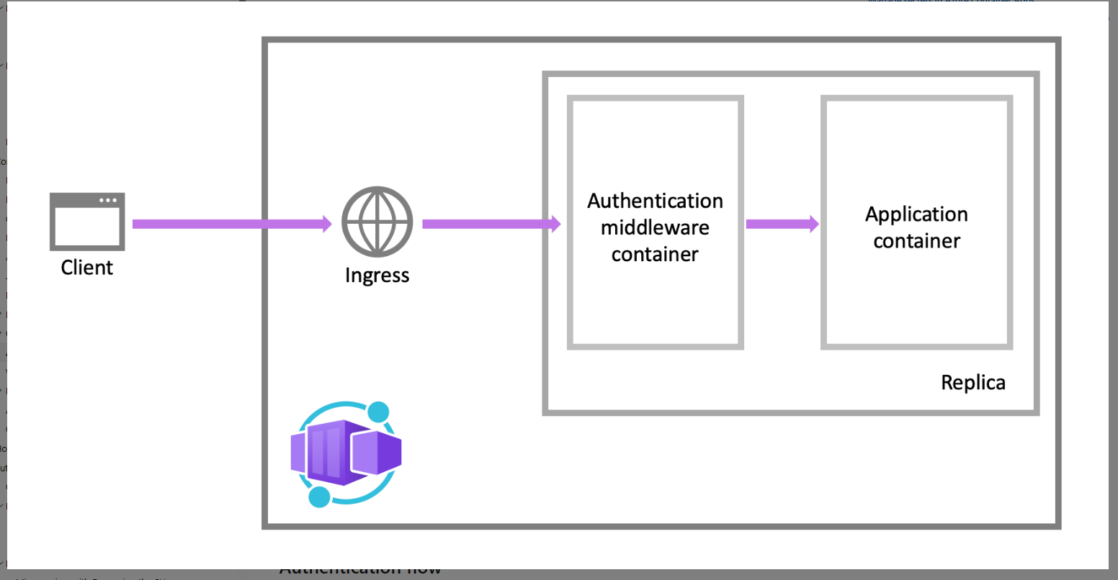
Authentication architecture

Slide 86
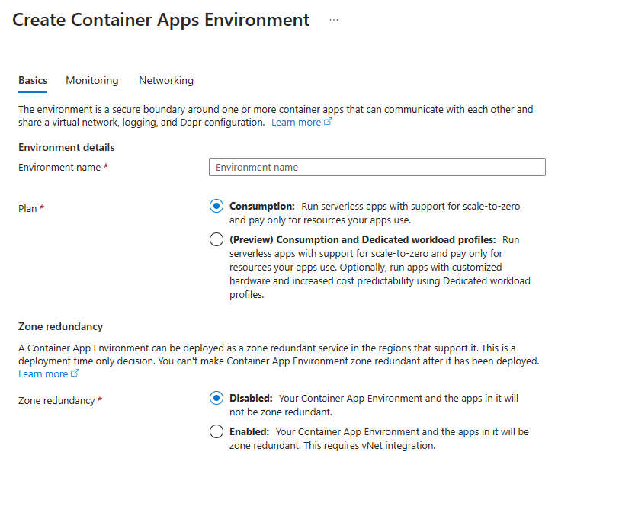
Disaster recovery options with Azure container Apps.

Slide 87
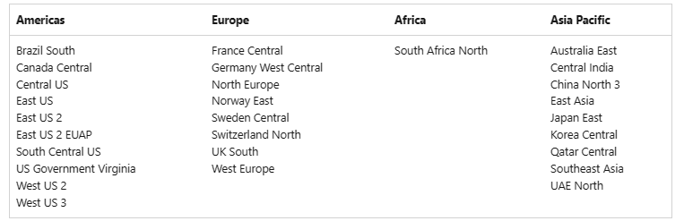
Disaster recovery options with Azure container Apps.
Regional Support
ACR Availability Zones are supported in the following regions:

Slide 88
Disaster recovery options with Azure container Apps
Region conversions to availability zones aren't currently supported.
To enable availability zone support in a region, create the registry in the desired region with availability zone support enabled, or add a replicated region with availability zone support enabled.
A registry with an AZ-enabled stamp creates a home region replication with an AZ-enabled stamp by default. The AZ stamp can't be disabled once it's enabled.
The home region replication represents the home region registry. It helps to view and manage the availability zone properties and can't be deleted.
The availability zone is per region, once the replications are created, their states can't be changed, except by deleting and re-creating the replications.
Zone redundancy can't be disabled in a region.
ACR Tasks doesn't yet support availability zones.

Slide 89
Module: 7
Understanding KEDA

Slide 90
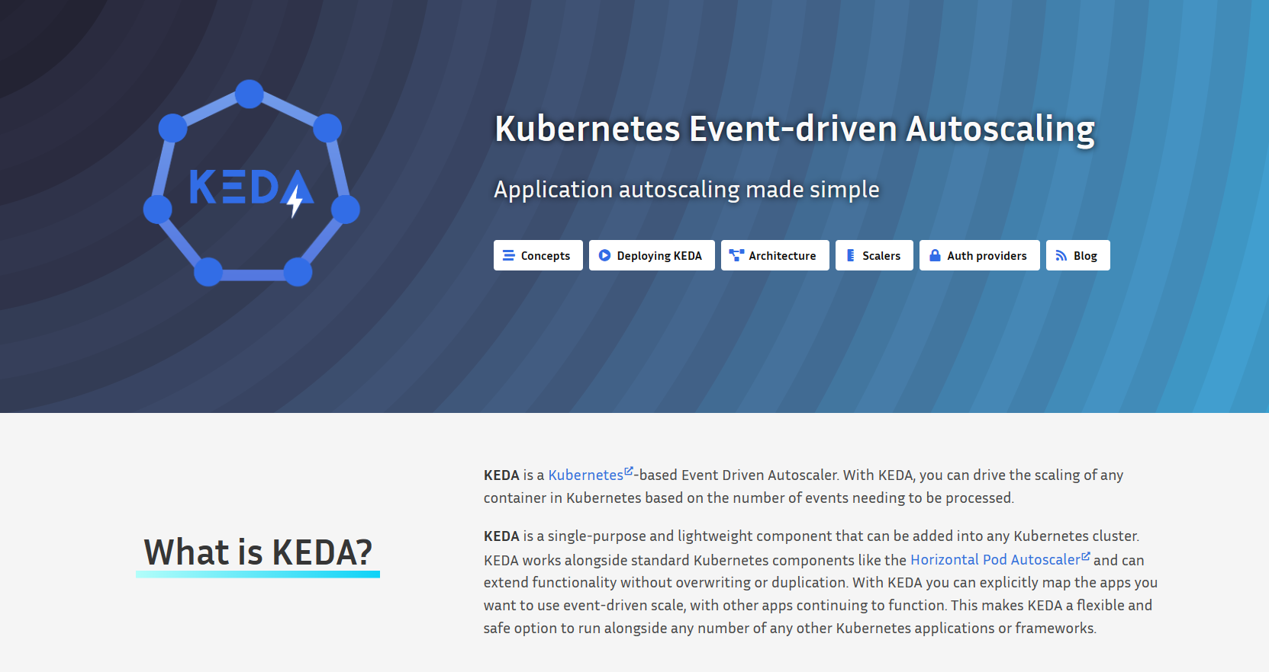
Kubernetes Event-driven Autoscaling (KEDA)
Kubernetes Event-driven Autoscaling (KEDA) is a single-purpose and lightweight component that strives to make application autoscaling simple and is a CNCF Incubation project.
It applies event-driven autoscaling to scale your application to meet demand in a sustainable and cost-efficient manner with scale-to-zero.
KEDA | Kubernetes Event-driven Autoscaling

Slide 91
Scaling
KEDA
HTTP
Event-driven
CPU
Memory
{
"name": "http-rule",
"http": {
"metadata": {
"concurrentRequests": 50
}
}
}
artemis-queue, kafka, aws-cloudwatch, aws-kinesis-stream, aws-sqs-queue, azure-blob, azure-eventhub, azure-servicebus, azure-queue, cron, external, gcp-pubsub, huawei-cloudeye, ibmmq, influxdb, mongodb, mssql, mysql, postgresql, rabbitmq, redis, redis-streams, selenium-grid, solace-event-queue, ..
{
"name": "cpu-rule",
"custom": {
"type": "cpu",
"metadata": {
"type": "Utilization",
"value": "50"
}
}
}
{
"name": "mem-rule",
"custom": {
"type": "memory",
"metadata": {
"type": "AverageValue",
"value": "512"
}
}
}
Support for scale to zero and specifying minimum/maximum replicas
Support for specifying minimum/maximum replicas
Notes:
When it comes to scaling, you have a number of choices here, some of which support scaling to zero.
Both HTTP scaling and Event-driven scaling support scaling to zero when there are no requests, or when there are no events to process.
HTTP scaling
With an HTTP scaling rule, you have control over the threshold that determines when to scale out. You define the maximum number of concurrent requests. Once the number of requests exceeds this value, then more replicas are added, up to the maxReplicas amount.
Event-driven scaling
Container Apps can scale based of a wide variety of event types. Any event supported by KEDA, is supported in Container Apps. Examples include: …
CPU scaling
CPU scaling allows your app to scale in or out depending on how much the CPU is being used utilizing the KEDA CPU scale trigger.
Memory scaling
Memory scaling allows your app to scale in or out depending on how much memory is being used utilizing the KEDA Memory scaler
You also have a choice to set a minimum number of instances that will always be up and running. Those will then be charged at a reduced “Idle” rate as long as those applications are not processing requests.

Slide 92
Lab: 5
Excercise 9 - ACA Auto Scaling with KEDA
Notes:
Refer to the following two modules in the lab - Azure Container Apps - Workshop
Module 9 - ACA Auto Scaling with KEDA

Slide 93
Module: 8
DevOps integration with Azure container Apps

Slide 94
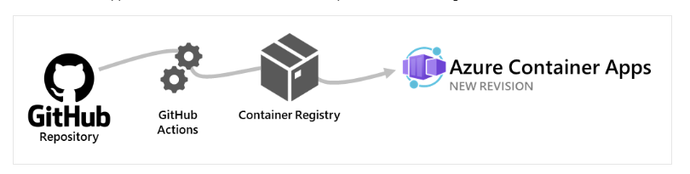
Deploy to Azure Container Apps with GitHub Actions
Build from a Dockerfile and deploy to Container Apps
Build from source code without a Dockerfile and deploy to Container Apps. Supported languages include .NET, Node.js, PHP, Python, and Ruby
Deploy an existing container image to Container Apps

Slide 95
Deploy to Azure Container Apps from Azure Pipelines
Azure Repos - Azure Repos is a set of version control tools that you can use to manage your code.
Git: distributed version control
Team Foundation Version Control (TFVC): centralized version control
Container Apps Azure Pipelines task
The task supports the following scenarios:
Build from a Dockerfile and deploy to Container Apps
Build from source code without a Dockerfile and deploy to Container Apps. Supported languages include .NET, Node.js, PHP, Python, and Ruby
Deploy an existing container image to Container Apps

Slide 96
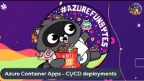
CI/CD Pipeline with Azure container Apps
Azure Container Apps - CI/CD deployments (Video Demo) (microsoft.com)

Slide 97
Lab: 6
Excercise 10 - Deployment Via Bicep and DevOps
Notes:
Refer to the following two modules in the lab - Azure Container Apps - Workshop
Module 10 - Deployment Via Bicep and DevOps

Slide 98
Module: 9
Landing zone accelerator for ACA
New features in Azure container Apps

Slide 99

Azure landing zone architecture
What is an Azure landing zone? - Cloud Adoption Framework | Microsoft Learn
An Azure landing zone is an environment that follows key design principles across eight design areas.
These design principles accommodate all application portfolios and enable application migration, modernization, and innovation at scale.

Slide 100

Azure Container apps Landing zone Accelerator
Azure Container Apps Landing Zone Accelerator (microsoft.com)

Slide 101
New features in ACA
Service connector (Preview)
CORS (Cross-Origin Resource Sharing)
Reference secret from Key Vault
Workload profiles in Consumption + Dedicated plan structure environments in Azure Container Apps
User defined Routes

Slide 102

Service connector-Demo

Slide 103

CORS (Cross-Origin Resource Sharing)
By default, requests made through the browser to a domain that doesn't match the page's origin domain are blocked. To avoid this restriction for services deployed to Container Apps, you can enable CORS

Slide 104

CORS (Cross-Origin Resource Sharing)
Notes:
Configure CORS in the Azure portal for Azure Container Apps | Microsoft Learn

Slide 105

Reference secret from Key Vault
When you define a secret, you create a reference to a secret stored in Azure Key Vault. Container Apps automatically retrieves the secret value from Key Vault and makes it available as a secret in your container app.
Notes:
Manage secrets in Azure Container Apps | Microsoft Learn

Slide 106

Workload profiles in Consumption + Dedicated plan structure environments in Azure Container Apps
Under the Consumption + Dedicated plan structure, you can use different workload profiles in your environment. Workload profiles determine the amount of compute and memory resources available to container apps deployed in an environment.

Slide 107

User defined routes (UDR) -preview
You can use UDR on the workload profiles architecture to restrict outbound traffic from your container app through Azure Firewall or other network appliances. Configuring UDR is done outside of the Container Apps environment scope. UDR isn't supported for external environments.

Slide 108
Lab: 7
Excercise 11 - Integration with Azure Container Apps landing zone accelerator
Notes:
Refer to the following two modules in the lab - Azure Container Apps - Workshop
Module 11 - Integration with Azure Container Apps landing zone accelerator

Slide 109
Get started with Azure Container Apps today
https://aka.ms/containerapps
Notes:
You can learn more about Azure Container Apps, or try it for yourself, at Azure.com.

Slide 110

Build your apps in Azure
mask
Notes:
The future will be defined by accelerating innovation.
Today we talked about our latest innovation on cloud native and open source and shared exciting news about the next generation of containers and serverless apps that empower every developer to take advantage of flexible choices to create microservices applications on Azure.
We can’t wait to see what you build!
Thank you!

